Slide 1

Andrew Stephan
ACCT 3220
Mechanics: Adjusting Entries Practice

Slide 2
Additional Adjusting Entries

Slide 3
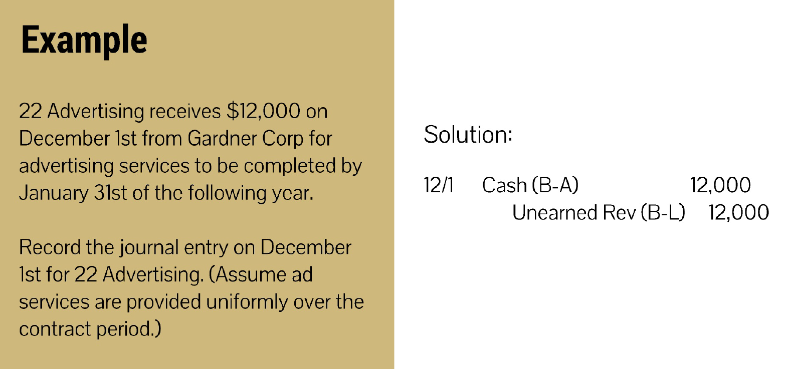
Notes:
Big question: Has anything changed between now and the period end?
Note some examples:
3) Advances/unearned revenue (cash advance so owe goods/services)
4) prepaids (insurance, magazine subscriptions)

Slide 4
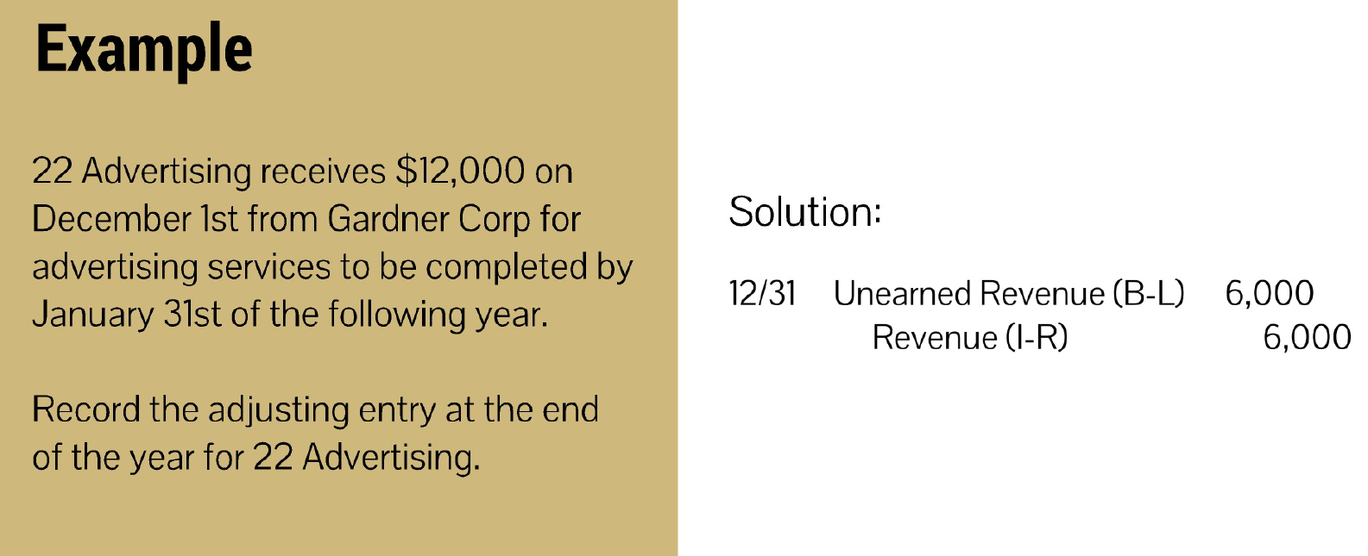
Notes:
Big question: Has anything changed between now and the period end?
Note some examples:
3) Advances/unearned revenue (cash advance so owe goods/services)
4) prepaids (insurance, magazine subscriptions)

Slide 5
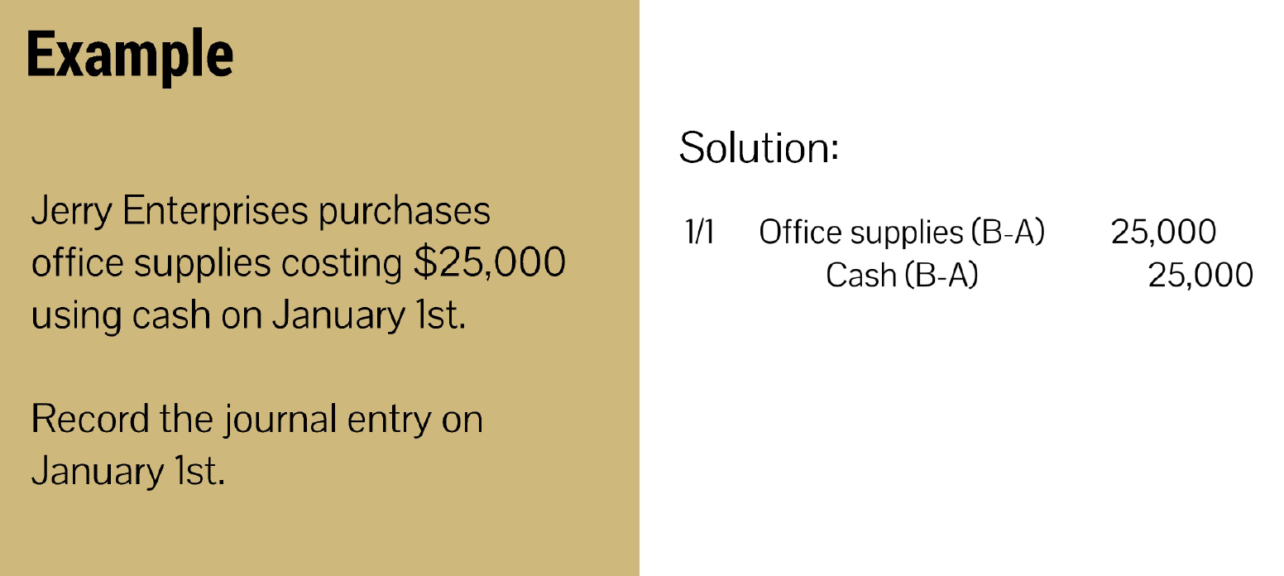

Slide 6
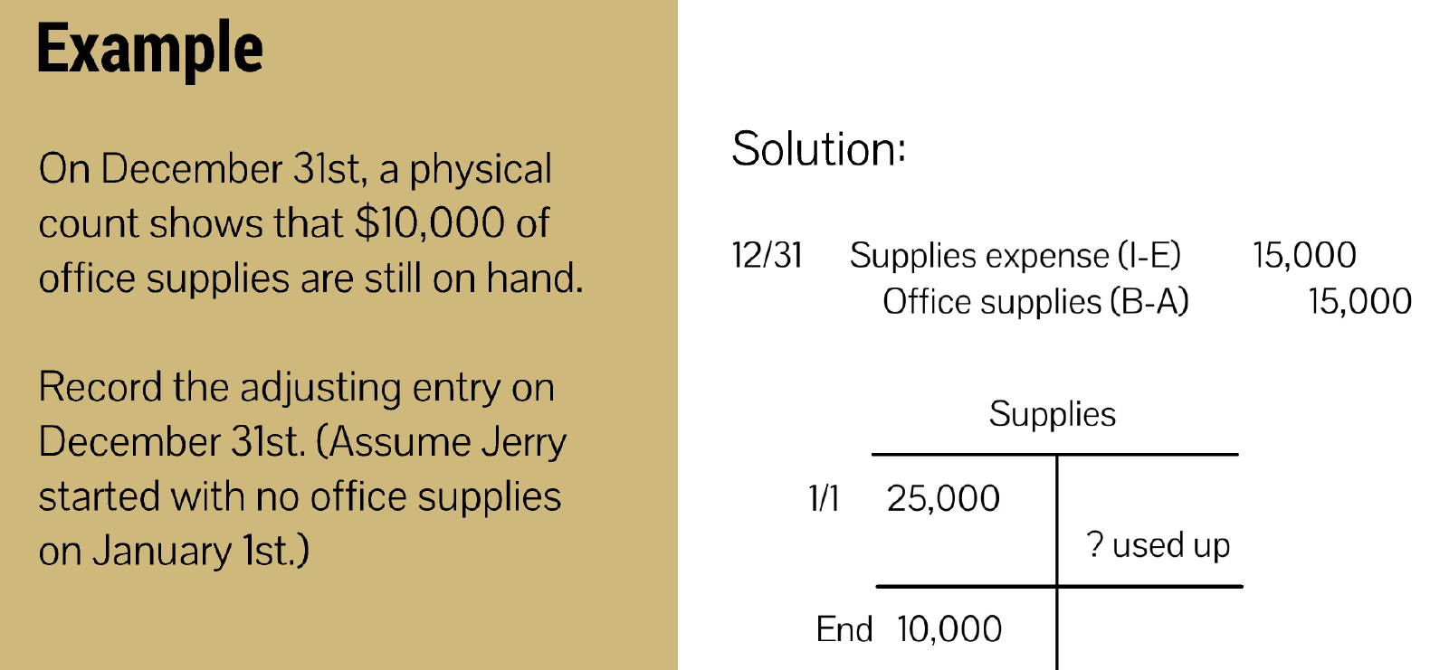

Slide 7
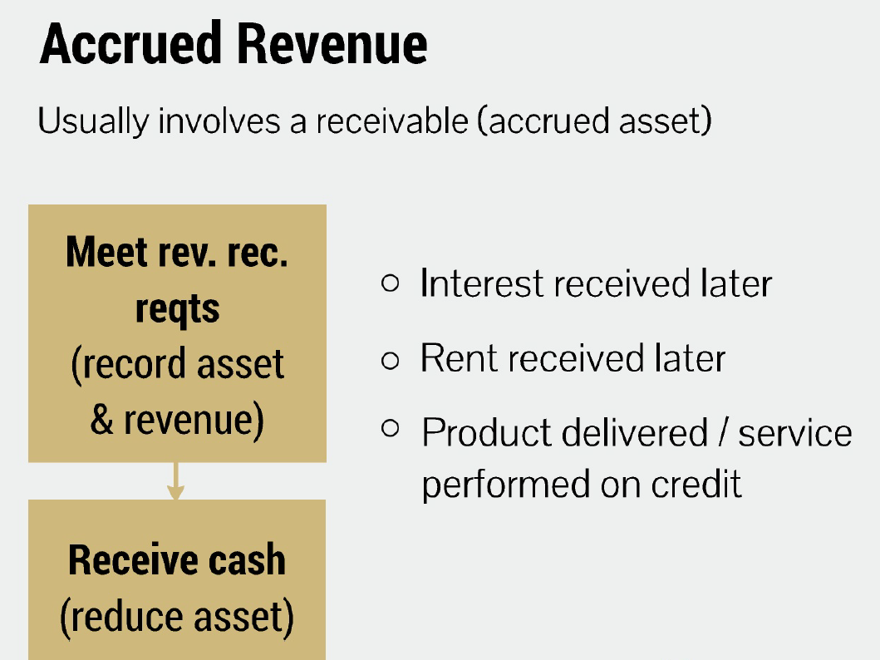

Slide 8
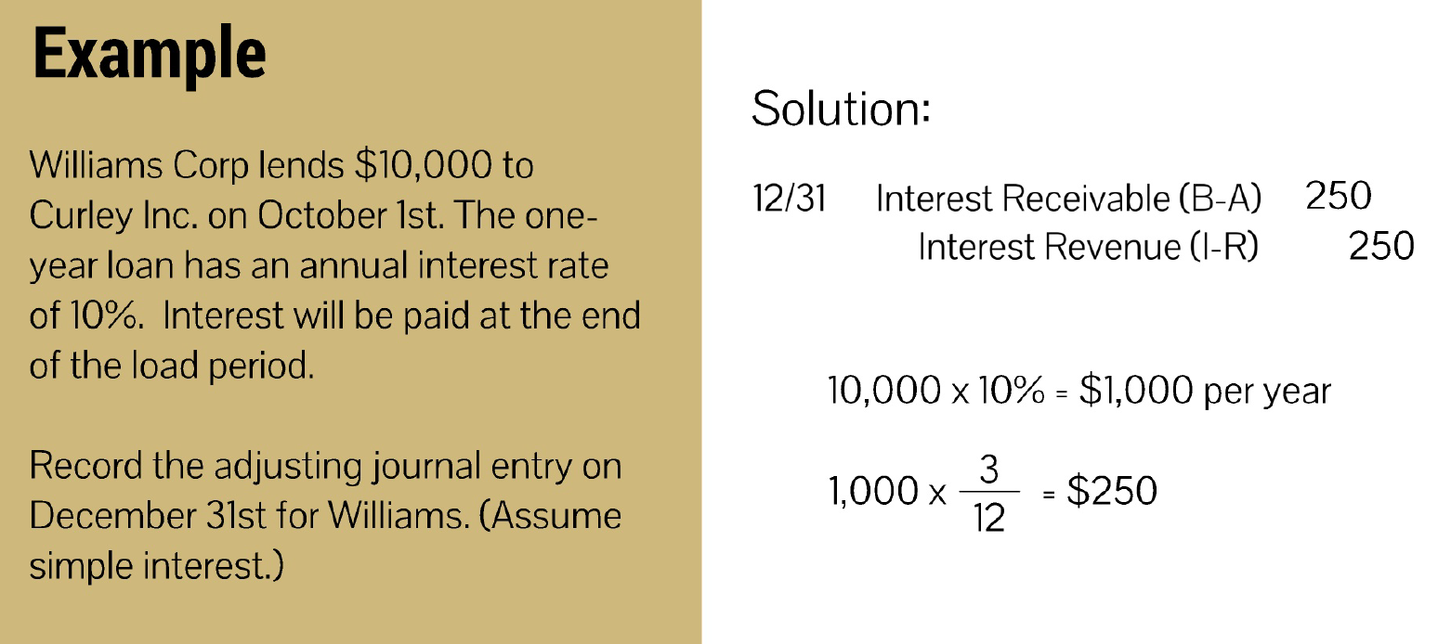

Slide 9
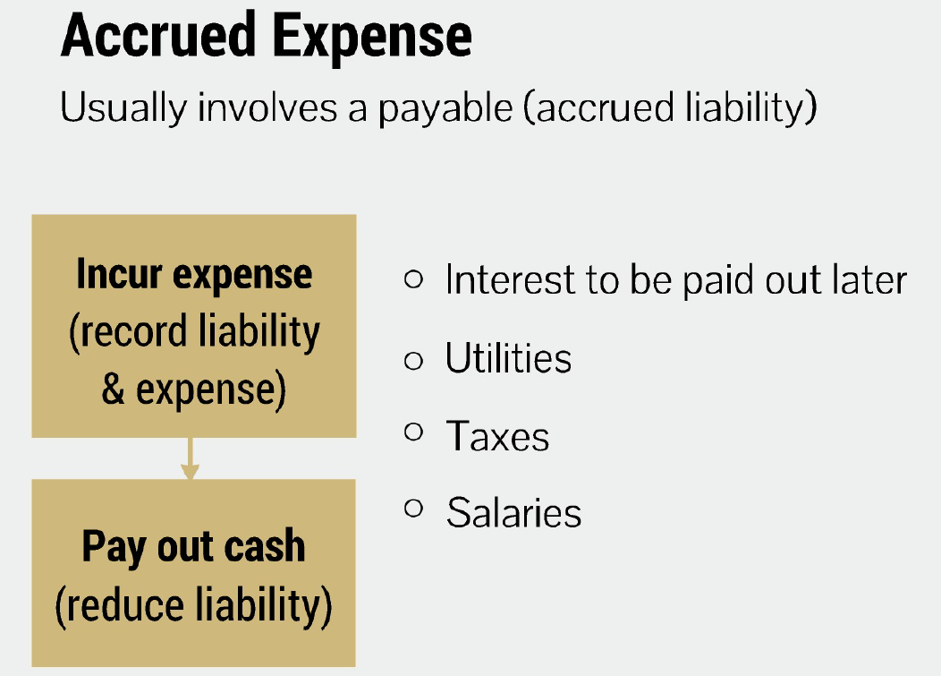

Slide 10
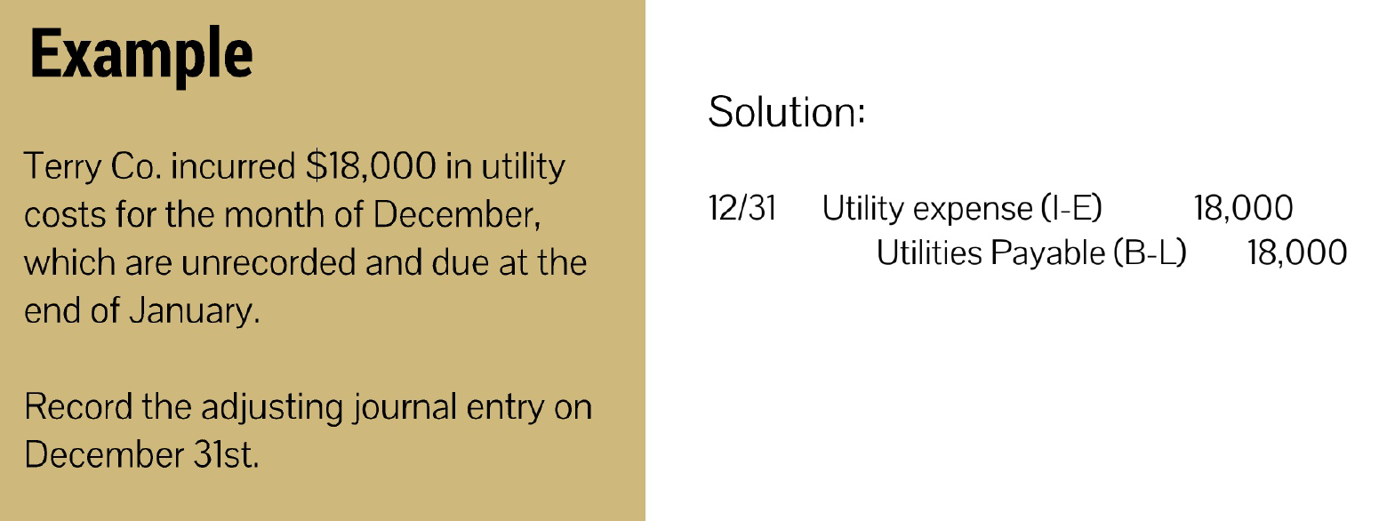

Slide 11
